Slide 1


Best Practise in Measurement
Week 5- Video 2
Dr Lucy Walker
Lucy.walker@mmu.ac.uk
Notes:
Hi Everyone, in this video I will be discussing what are the elements and pitfalls to best practise in psychological measurement.
A forensic psychologist practitioner may encounter the delivery, scoring and providing feedback for a range of psychological tests. With this comes some expectations of how the tests are delivered and what the consequences mat be of not following these best practise guidelines.

Slide 2
What is best practise?
Psychological assessments are potent tools, if misused or used negligently they can cause a plethora of issues
Users must be licensed or qualified- adhering to codes of practise
Notes:
Psychological measurements are a tool but delivered in the wrong way they can cause a lot of issues.
The results from these types of tests are often used to inform large decisions, decisions that may disrupt family life, cause the loss of partners or children, and even lead to the loss of jobs and homes.
On the other hand if poor measurement administration is carried out, this could lead to litigation again the test administrator.
These are all serious implications of the improper use of psychological measurements- and because of this users of these tests must often have to be licenced or qualified registered with a professional body such as the BPS.
Codes of practise- APA and BPS: Code of Ethics and Conduct (2006), Generic Professional Practice Guidelines (2008) for psychologists having a section on assessment, and a Code of Practice for Psychological Testing (2003).

Slide 3
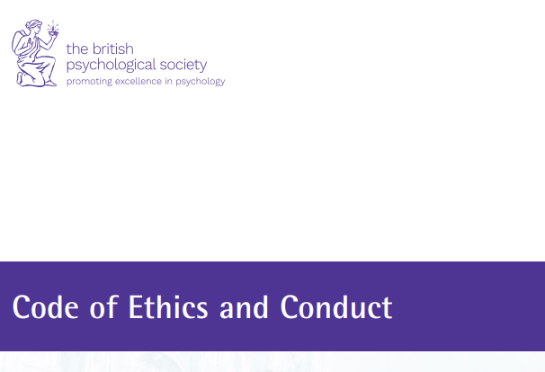
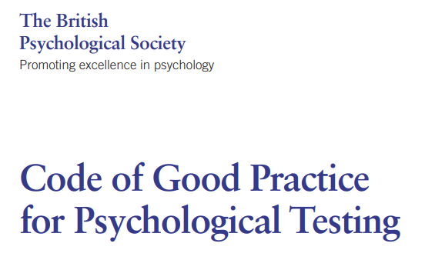
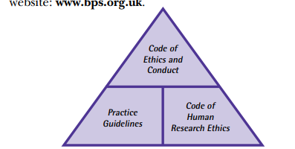
Professional Practise guidelines
Notes:
These professional bodies that practitioners often have to be registered with, publish their own guides on the best practise for psychological measurement.
The APA- American psychological association has their own, but for the purposes of your Msc being accredited by the BPS we will focus on the BPS guidelines.
These guidelines include – the
1. Code of Ethics and Conduct (2018)- hopefully you will all have come across these guidelines within your time as a psychological students, they set out the way in which as psychologists and researchers we should conduct our selves in an ethical manner
2. Generic Professional Practice Guidelines (2008) for psychologists, this has a specific section on assessment, outfling what how practitioners should conduct themselves when administering tets.
3. Code of Practice for Psychological Testing (2003). Is a more specific guide that looks specifically at psychological testing.
All guides can be found on the BPS website- if you feel like taking a look at the specific guidance.

Slide 4
Fairness in Testing
Representation of the Norm group
Direct and Indirect discrimination
What components of measures make them unfair?
Notes:
Now we have covered what the gold standard for psychological measurement testing administration is, we can now look at some of the inherent issues with the types of tests used.
Unfortunately most early tests have been standardized for use using a norm group sample compromising of largely white individuals.
Because of this, we should start to question the validity of these assessments.
If we apply this to our own norm group (mostly Msc psychology students) how representative would this be of the wider population?
All people should be considered fairly
Including but not limited to because of their- gender, race, religion, colour, ethnic origin or background, age, sexual orientation or disability.
The use of these tests become widespread, indicating that not all people taking these tests would be fairly treated when being compared to the norm group socres.
This can then lead to discrimination of the groups not represented, Both indirect and direct discrimination is recognised by the law in both the US and UK.
Direct discrimination in psychological measurement may come from the fact psychometric tests may reveal personal information of the person, such as mental health or disability status in which for example if the test is taken in the context of employment- could lead to direct discrimination of the individual.
Whereas
Indirect discrimination- this can come about due to the content of a measurement, if the measurement is based on a norm group not representiative of the test taker. The test may require special knowledge, or items related to attitudes or even culturally bound meanings. These factors may underpredict the performance of the test taker, causing indirect discrimination of the individual.
In UK law when making a complaint regarding discrimination- you do not need to evidence any discriminatory intent on the part of the decision-maker. The case is instead based on the argument that there is something the decisionmaker does or fails to do which results in discrimination,
This could be evidenced by a disproportionate number of people affected that come from a specific group.

Slide 5
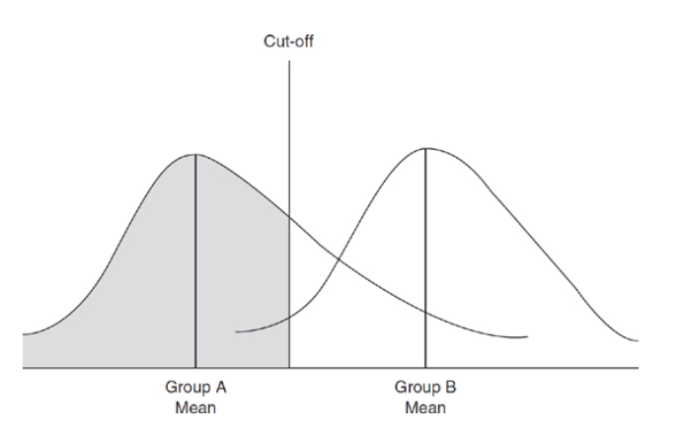
Checking Bias and Using Cut-offs
Image from the Coaley text book on your reading list- chapter 10
Notes:
We have covered cut offs in previous lectures and workshops, but lets look at them now through the lens of bias.
In an ideal world we want there to be minimal group differences when we administer tests, but bias can occur when differences can be seen.
In the previous video you were introduced to a range of techniques that have been developed for detecting.
But what if this bias is left undetected?
For example looking at this graph a test was taken by two different demographic populations, it shows that both groups show a different distribution of scores, one with a lower mean (group A). If we apply the same cut off point for this test on both groups- the group with the lower mean score will have their performance underpredicted, while the higher scoring group is overpredicted.
Therefore in this case the use of group related cut off point would be a fairer option, however separate norm group tables for evaluating test performance is not advised.
The Commission for Racial Equality (the CRE)- does not recommend this practise. Instead the norm group should be as similar as possible to the test takers- meaning they should represent all manner of gender, educational backgrounds, age and ethnicities.
So it might be time to rethink the standardization of some of these old tests.

Slide 6
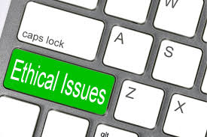
Ethical Considerations
Data protection legislation-covers personal data
Confidentiality and Security
Informed consent
Notes:
Now we have discussed bias of the test itself, lets now move on to the ethical consideration of test administration
Firstly is the issue of Data protection
Types of Sensitive’ data include a person's:
Ethnic origin
Beliefs and opinions, for example on religion or politics
Disabilities
State of physical or mental health
Sexual orientation
Any convictions, offences committed or legal proceedings
All of some of which may be asked when conducting psychological measurements. The use of this data needs to follow GDPR and ethical guidelines, the processes of storing and collecting this data you may have come across to some extent when designing your own dissertations projects.
To knowingly misuse or disclose personal information and types of sensitive data is a criminal offense, therefore processes are put in place to manage this.
A second issue is Confidentiality and security
Psychological measurements often include sensitive information, which should not be communicated to others without permission or good reason to do this. For example information shared with the courts to inform a legal process.
Information in the context of Forensic tests often give complex information, that should be handled with care and interpreted with skill.
If tests scores are leaked or shared without permission, these could be misused to the determent of the test taker.
Lastly Informed consent is a major ethical consideration
As in research when using psychological measurements we need to gain consent and give the right to withdraw.
In order for consent to be gained the purpose of the test needs to be explained in detail.
The test taker also has the right to know what their score is and what this means- this is when skilled interpretation comes in to play.

Slide 7
Professional issues in testing
Training
Administration error
Testing environment
Introducing the test
Use of scripts
Notes:
As well as ethical consideration, a number of factors need to be controlled when administering tests.
Although no formal regulations are published for most tests on how they should be administered, they should be administered in the most similar way across all test-takers. Exceptions are made to accommodate different groups for example children or disabilities.
The main aim is to administer the test in the same way it was administered during standardization, anything different has not been validated.
To do this training is needed! If trained to administer the test in the correct way reliability of the test in ensured, reducing the chance of administration error contributing to the score.
A second consideration is test environment. A range of aspects including light, temperature of the room can effect the test takers score. In addition to this the sex of the administrator may also impact this, creating differences in physiological arousal and in turn the score.
How the test is Introduced may also influence the results
When introducing the test- participant need to be told what to expect, this will help to manage levels of anxiety in the test taker. Information should include how long the test will take, and reassurance. In the case of intelligence testing reassurance could take the form of advising that not many people get all items correct.
Whereas in personality tests, reassurance can indicating that there is no right or wrong answer and participants should answer as honestly as they can.
Lastly a large amount of psychological measurements come with scripts for administration. These scripts should be followed carefully and delivered without unnatural emphasis. Scripts are helpful as they allow for identical administration between participants. However the slightest deviation from scripts could cause test differences, for example if delivered in more friendly tone versus a more neutral tone, could cause differences in physiological stress and therefore test scores.

Slide 8
Scoring tests
Following instructions
Manual vs computerised scoring
Interpretation
Giving Feedback
Notes:
A large component of test administration is the scoring.
Measurement manuals should include scoring instructions, which should be followed both accurately to avoid error.
In some cases but not all computerized scoring may be available, however as tests have often been standardized for in person completion this is not always possible.
For manual scoring- test manuals often include marking keys, which include counting correct items to produce the score. Instead Test takers may be asked to self score their test- using keys on sealed sheets of paper. Self-scoring has its own issues and should be careful monitored.
The Raw scores produced by scoring are meaningless without interpretation. A reminder that the raw score is the un-transformed observed score for any measurments
This is when our percentiles, standardised scores (t scores z scores) come in to play. These scores mean we can compare scores again the norm group and make interpretations.
Some manuals will direct you to a norm group scores- the norm group that best matches the test taker should be chosen.
Lastly once scoring and interpretation has been completed its time to Give feedback.
Feedback regarding a test should be delivered in an understandable way to the testtaker and possible other parties. The administrator has responsibility to the test taker to give feedback sensitively and ethically. If scores are feedback incorrectly this can cause distress to the the individual, this is especially important then in a clinical or forensic setting scores and feedback relate to clinical disorders or important decisions in a persons life.
Forensic psychologist may also be required to produce feedback in the form of a written report for third parties- for example to the courts. If this report misrepresents the participants score, this may have big implications for the rest of the testtakers life.

Slide 9
Checking Bias- Scoring
Defence
Prosecution
Image from the Coaley text book on your reading list- chapter 11
Notes:
Remember previously when we looked at bias of cut offs between different norm groups, well this can be applied to bias in scoring.
In a study conducted by Murrie at al in 2013
They paid forensic psychologists to review an offenders case file- some were told they were consulting for the defence and others for the prosecution. When interpreting and scoring results from the PCL-R (Psychopathy-checklist revised).
Those who believed they were working for the prosecution tended to assign higher scores to offenders,
whereas those who believed they were working for the defence tended to assign lower risk scores to the same offenders.
In this case if we were to apply our cut off scores for the PCL-R within the UK – which is 25, the prosecution scores would be more likely to fall above the cut off.
This demonstrates how bias can occur within the scoring and interpretation of tests.

Slide 10
Fairness in practice- On the internet
The past year has seen a large shift of major events on to an online space.
How would this shift impact psychological testing and assessment?
The benefits of these medium could include speed of use, lower costs and convenience to the test taker. Access to testing is also increased.
The issues of this medium could include security of the test, the influence of the test device, amateur efforts
Notes:
In the context of COVID-19 alot of elements of psychology practise have been moved to an online space. If this is the case for psychological measurements, what could the implications of this be?
The benefits of this space, include speed of use, lower costs to both test taker and administrator organisations and increased access to lots of marginalised groups.
However with these benefits come issues.
One of the most prominent issues is the security of the test and storage of information, protocols need to be put in place to manage data storage.
Another issue is the influence of the online space on error in tests
For example, Tseng et al., (1998) have shown that levels of computer anxiety can affect participants’ responses in different ways de-pending on the technology used to gather data (PC vs. pen-basedpersonal digital assistant). May be influenced by level of computer literacy.
Davis also indicated that -online respondents tend to report higher levels of negative affect than participants filling out paper-and-pencil questionnaires (Davis, 1999).
Lastly one major issue of psychological measurements online is the rise of unstandardised or regulated tests popping up.
We have all seen these tests and quizzes online, when taken without being properly informed can cause ethical issues. Plus there is no evidence that these instruments have any degree of reliability or validity. (Buchanan & Smith,1999b).

Slide 11
Thank you for listening
Some important references.
Murrie, D. C., Boccaccini, M. T., Guarnera, L. A., & Rufino, K. A. (2013). Are Forensic Experts Biased by the Side That Retained Them? Psychological Science, 24(10), 1889–1897. https://doi.org/10.1177/0956797613481812
Coaley, K. (2010). Best practice in assessment and testing. In An introduction to psychological assessment and psychometrics (pp. 229-252). SAGE Publications Ltd, https://www-doi-org.mmu.idm.oclc.org/10.4135/9781446221556.n10
The British Psychological Society, 2018. Code of Ethics and Conduct. [online] Leicester: The British Psychological Society. Available at: <https://www.bps.org.uk/sites/bps.org.uk/files/Policy%20-%20Files/Code%20of%20Ethics%20and%20Conduct%20(2018).pdf> [Accessed 23 May 2018].

